Slide 1
GULF INTRACOASTAL WATERWAY (GIWW) Caloosahatchee River to Anclote River
DREDGE READINESS AND OPERATION PLAN (DROP)
Laurel P. Reichold, E.I.
Project Manager
U.S. Army Corps of Engineers Jacksonville District
FSBPA Tech Conference
February 7, 2019
Trusted Partners Delivering Value Today for a Better Tomorrow
CHARLESTON
JACKSONVILLE
MOBILE
SAVANNAH
WILMINGTON
US Army Corps of Engineers
BUILDING STRONG®

Slide 2
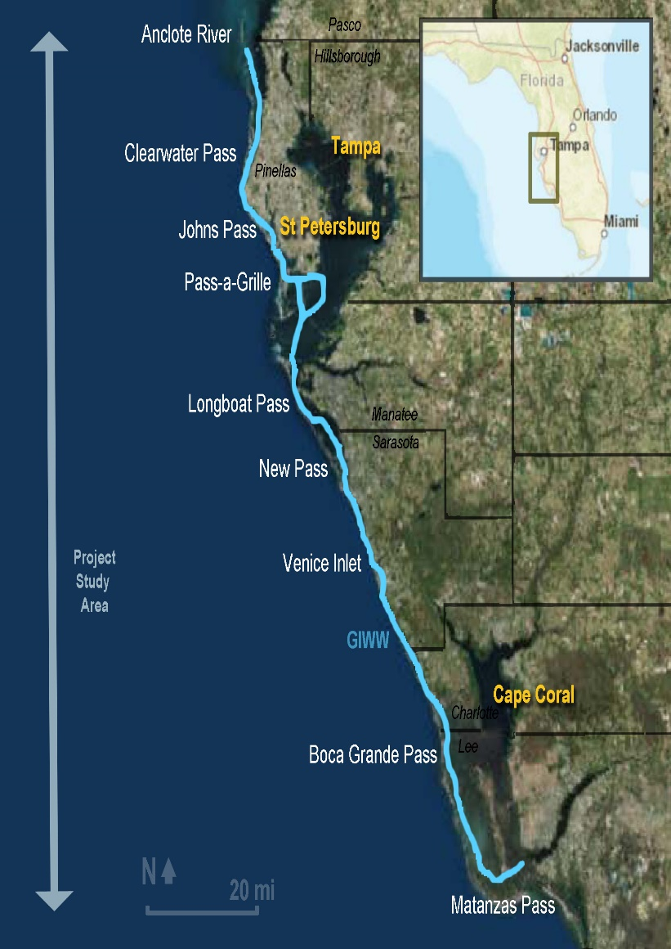
Gulf Coast Intracoastal Waterway Overview: Caloosahatchee River to Anclote River
BUILDING STRONG
160 miles Caloosahatchee to Anclote.
1945 authorization.
9 foot depth X 100 feet wide.
Construction completed 1967.
Periodic dredging as needed.
Full bathymetric survey conducted in 2016/2017.
Full bathy planned 2019/2020.
Region includes 9 Federal inlets.

Slide 3
What does it mean to be Dredge Ready?
Dredge Readiness and Operation Plan
Objectives
BUILDING STRONG
Immediate Response: Post-storm shoaling removal (dredging within 3 months max).
Future Operation: Having a 10-15 year plan for removing shoals, knowing problems areas, and lining up budgets.
Goals for GIWW and Associated Federal Inlets:
Increased efficiency and response in channel management and maintenance.
Regional approach in sediment management, environmental assessment and permitting.
Beneficial use as primary consideration for dredged material.
Notes:
Low Use Navigation: Low funding prioritization, inlets not routinely dredged, nor funded for typical O&M data activities, no R&D funding to understand dynamics and erosion downdrift.
Limited Regional Focus: Lack of regional perspective and coordinated plan to marry up inlet dredging with beach nourishment needs, or inlet management to address beach erosion issues.
Data Needs for Permit Compliance: Typical data requirements include geotech, SAV surveys, beach compatibility assessments, cultural resource survey, all require lead time, and some have expirations if dredging not completed shortly thereafter.

Slide 4
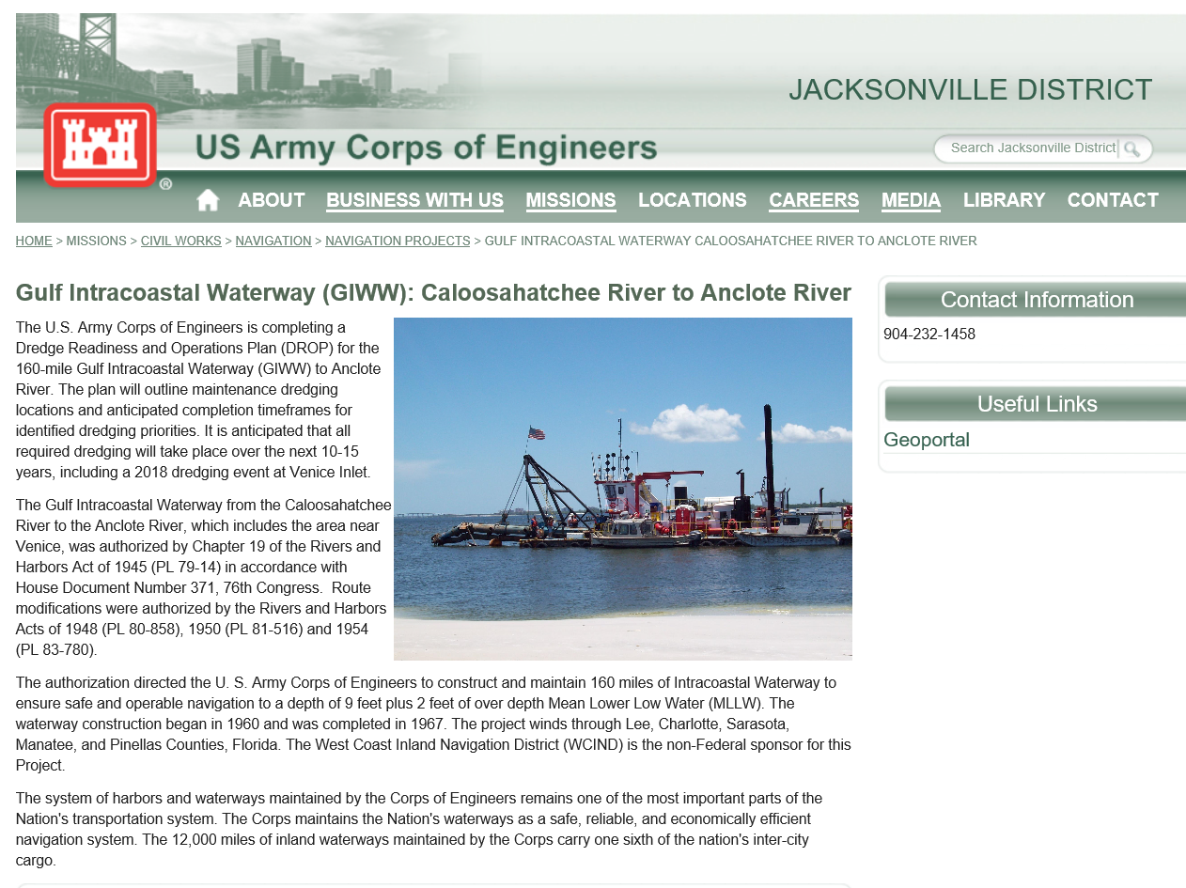
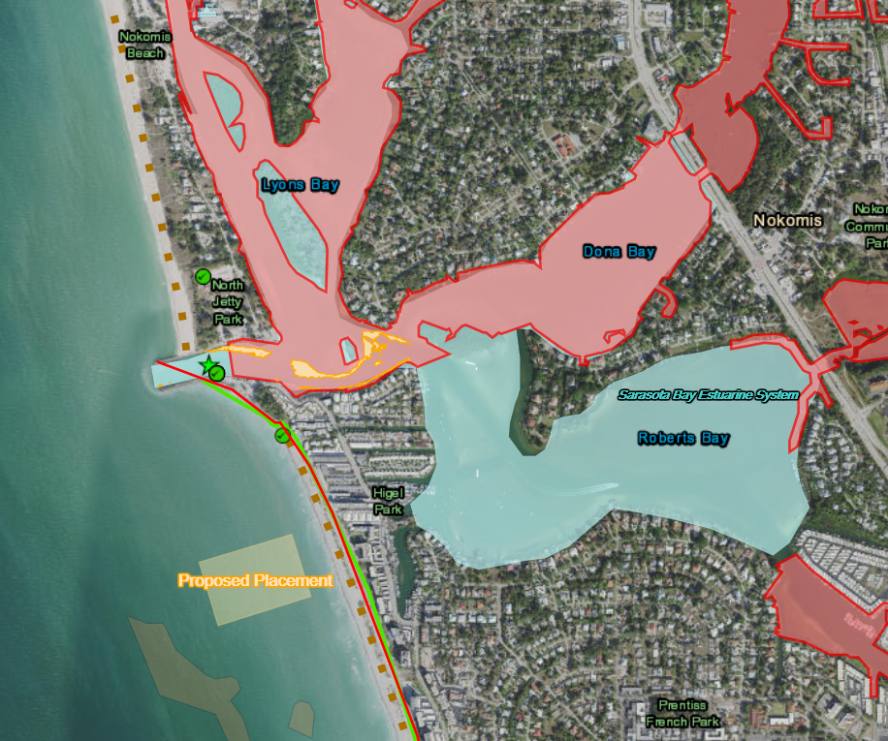
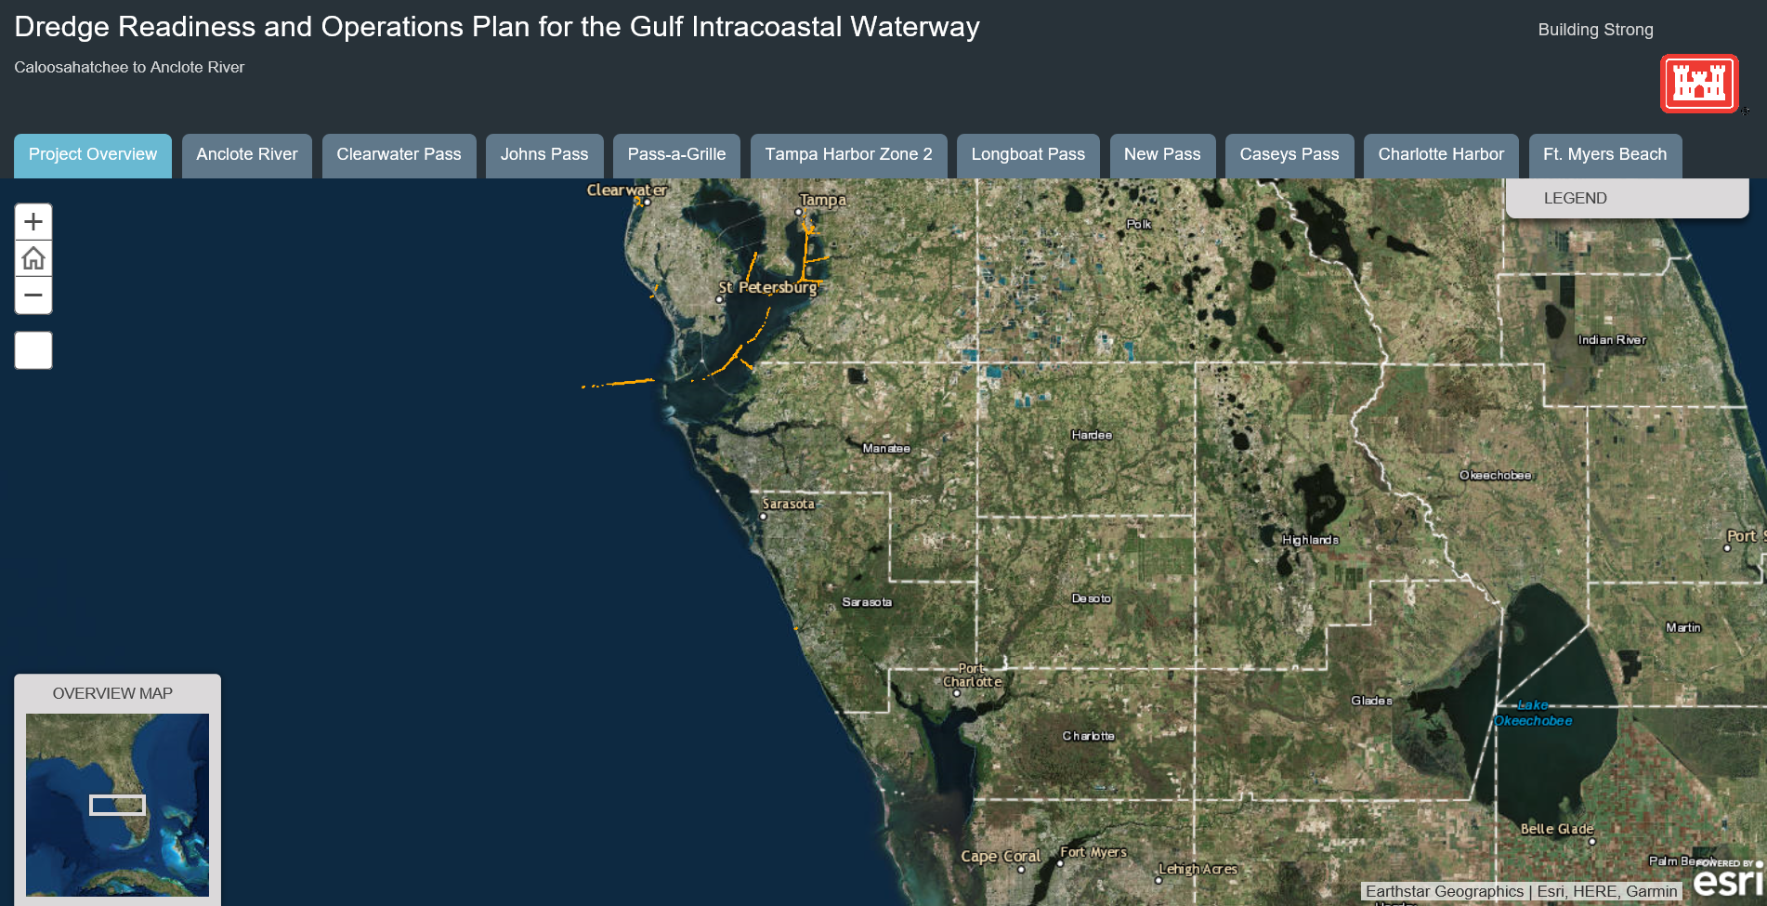
Accomplishments to date: Public accessible geodatabase
BUILDING STRONG
https://arcg.is/8zLH8
https://www.saj.usace.army.mil/GIWWCRtoAR/
Notes:
Pull all data together into one location for assessment.
Challenge, sifting through what is the most relevant data, what data to populate. What matters to different stakeholder. Training ourselves to use the tool.
Key to a geoportal is once established, low to no manual uploading required, linking to self populating sites like USFWS, or EPA, or State….

Slide 5
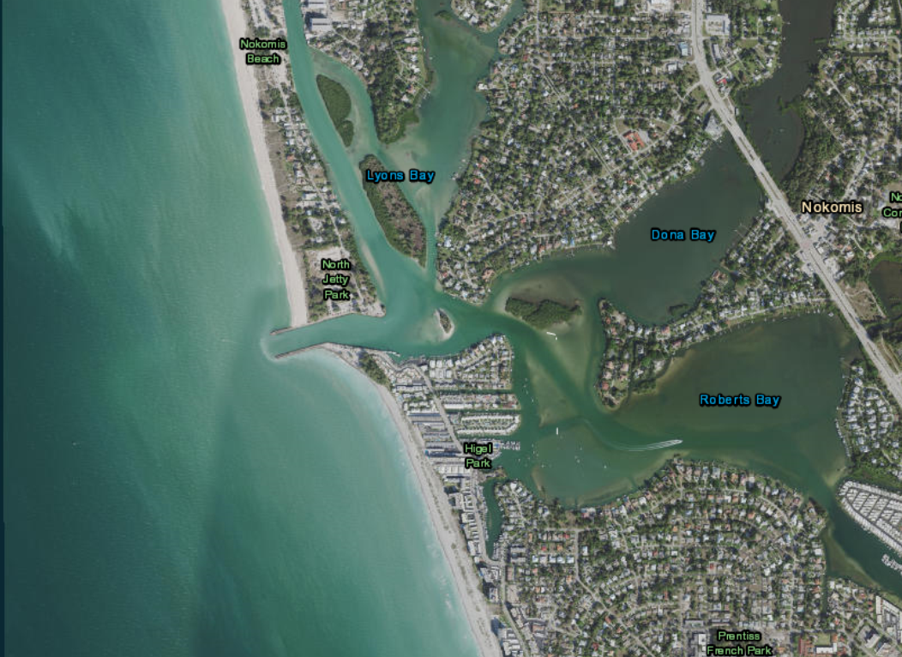
Accomplishments to date: Public accessible geodatabase
BUILDING STRONG
https://www.saj.usace.army.mil/GIWWCRtoAR/
Notes:
Pull all data together into one location for assessment.
Challenge, sifting through what is the most relevant data, what data to populate. What matters to different stakeholder. Training ourselves to use the tool.
Key to a geoportal is once established, low to no manual uploading required, linking to self populating sites like USFWS, or EPA, or State….

Slide 6
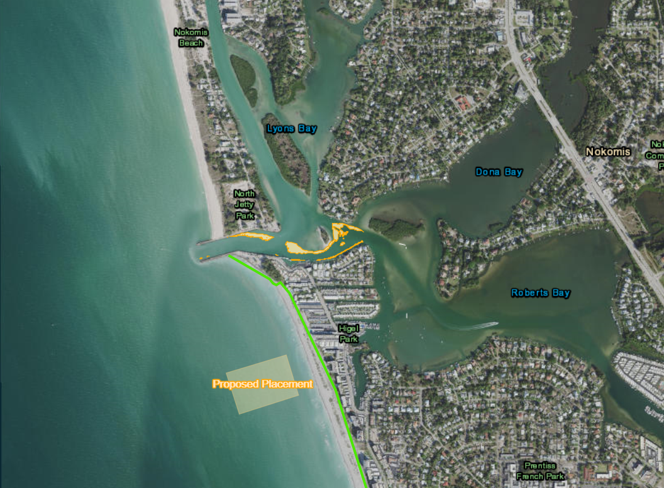
Accomplishments to date: Public accessible geodatabase
BUILDING STRONG
https://www.saj.usace.army.mil/GIWWCRtoAR/
Notes:
Pull all data together into one location for assessment.
Challenge, sifting through what is the most relevant data, what data to populate. What matters to different stakeholder. Training ourselves to use the tool.
Key to a geoportal is once established, low to no manual uploading required, linking to self populating sites like USFWS, or EPA, or State….

Slide 7
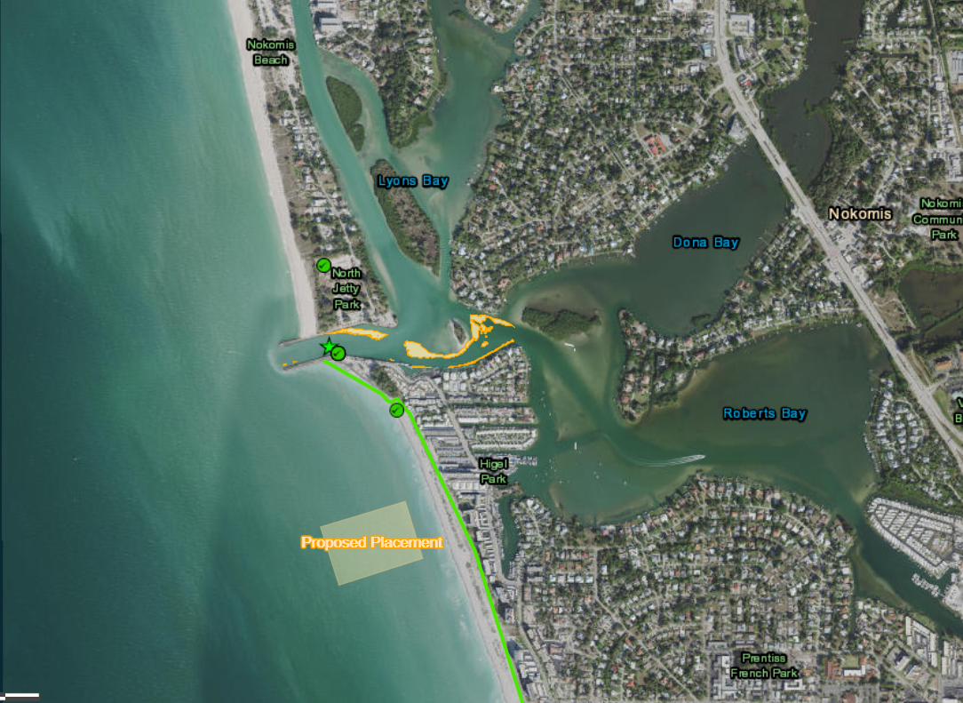
Accomplishments to date: Public accessible geodatabase
BUILDING STRONG
https://www.saj.usace.army.mil/GIWWCRtoAR/
Notes:
Pull all data together into one location for assessment.
Challenge, sifting through what is the most relevant data, what data to populate. What matters to different stakeholder. Training ourselves to use the tool.
Key to a geoportal is once established, low to no manual uploading required, linking to self populating sites like USFWS, or EPA, or State….

Slide 8
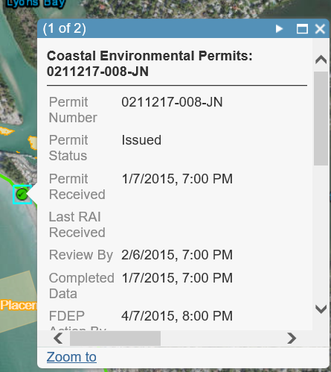
Accomplishments to date: Public accessible geodatabase
BUILDING STRONG
https://arcg.is/8zLH8
https://arcg.is/8zLH8
https://www.saj.usace.army.mil/GIWWCRtoAR/
Notes:
Pull all data together into one location for assessment.
Challenge, sifting through what is the most relevant data, what data to populate. What matters to different stakeholder. Training ourselves to use the tool.
Key to a geoportal is once established, low to no manual uploading required, linking to self populating sites like USFWS, or EPA, or State….

Slide 9
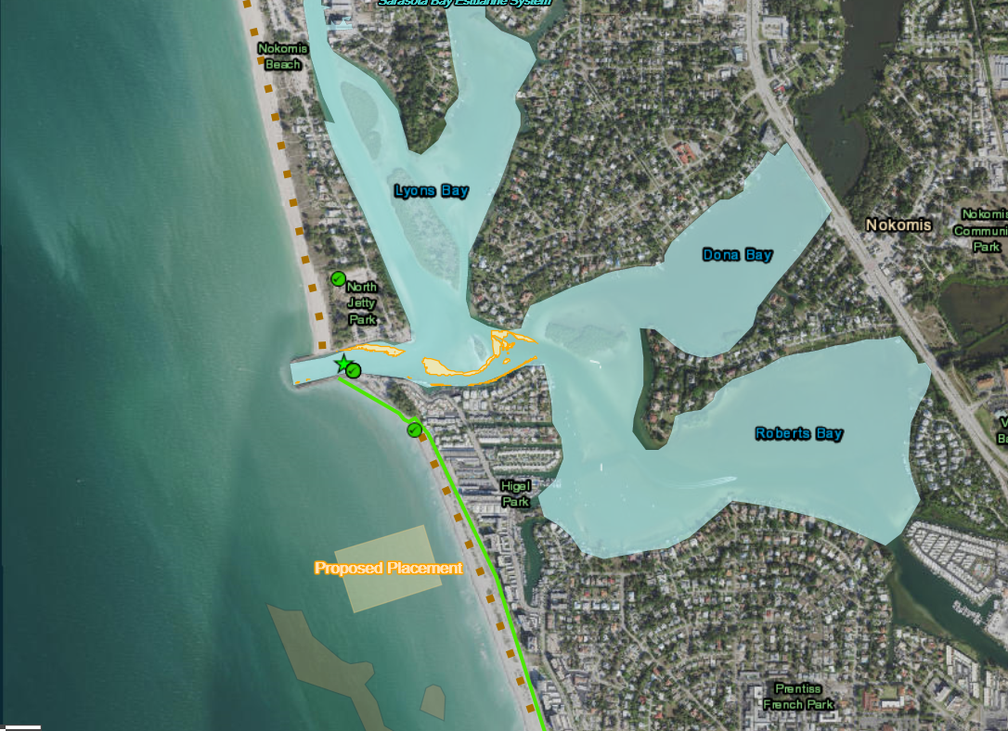
Accomplishments to date: Public accessible geodatabase
BUILDING STRONG
https://arcg.is/8zLH8
https://www.saj.usace.army.mil/GIWWCRtoAR/
Notes:
Pull all data together into one location for assessment.
Challenge, sifting through what is the most relevant data, what data to populate. What matters to different stakeholder. Training ourselves to use the tool.
Key to a geoportal is once established, low to no manual uploading required, linking to self populating sites like USFWS, or EPA, or State….

Slide 10
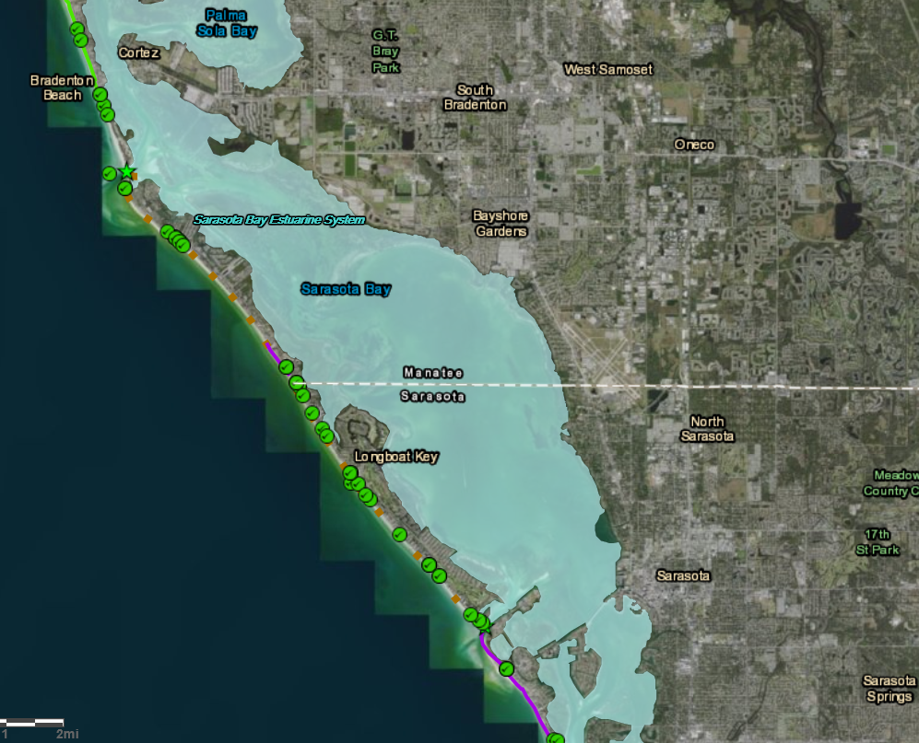
Accomplishments to date: Public accessible geodatabase
BUILDING STRONG
Stakeholder database
Used for environmental assessment documents and permitting
Used to help identify data gaps
https://arcg.is/8zLH8
https://www.saj.usace.army.mil/GIWWCRtoAR/
Notes:
Pull all data together into one location for assessment.
Challenge, sifting through what is the most relevant data, what data to populate. What matters to different stakeholder. Training ourselves to use the tool.
Key to a geoportal is once established, low to no manual uploading required, linking to self populating sites like USFWS, or EPA, or State….

Slide 11
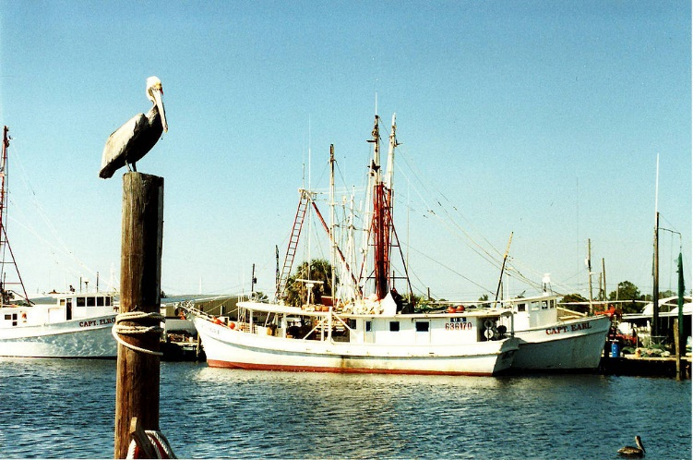
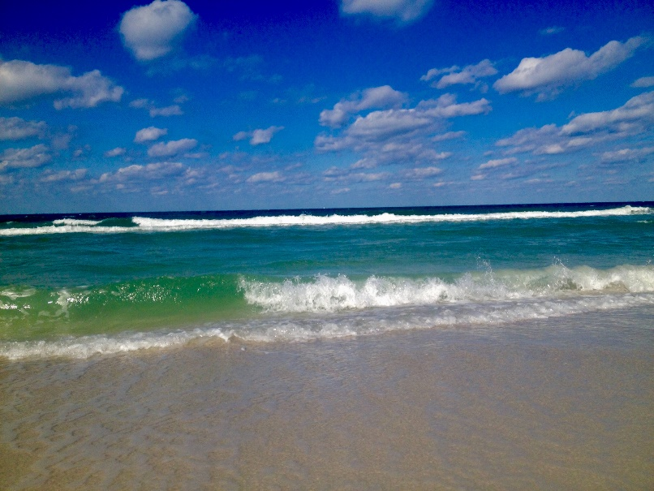
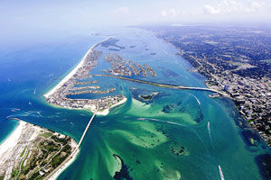
Accomplishments to date: Stakeholder engagement
BUILDING STRONG
WCIND
Coast Guard
Counties
Municipalities
Boaters
Fishing industry
Florida DEP
US Fish & Wildlife
FWC
NOAA/NMFS
Tribes
State Historic Preservation
© 1988 by James G. Howes
Tbnweekly.com
By Slapp9 - Own work, CC BY-SA 4.0, https://commons.wikimedia.org/w/index.php?curid=63414380

Slide 12
Accomplishments to date: Comprehensive Programmatic EA
BUILDING STRONG
Assessment of entire GIWW and associated Inlets.
Identification of data needs (static vs. dynamic).
Identification of potential placement sites.
Development of a Regional General Permit for local maintenance dredging with disposal and beneficial reuse.
Notes:
Limit general permit to our non-federal sponsor, not open ended.
we want to develop a programatic state permit that allows expedited review of each inidivual proposed event, and also expedited coordination under EFS, ESA

Slide 13
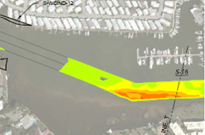
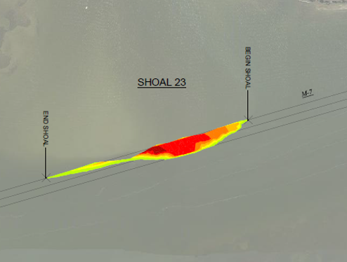
Accomplishments to date: Dredging Prioritization
Review of Bathymetric Data
40% of the 160 miles had reported shoaling
3 inlets had urgent dredging needs
6 inlets planned for borrow source dredging -> CSRM
1 inlet recently dredged
BUILDING STRONG
Criteria for dredging
50% channel width
On average >1cy/ft shoaling
On average shoaling depth 3ft above authorized depth
Notes:
Review of bathy data to determine shoaling areas

Slide 14
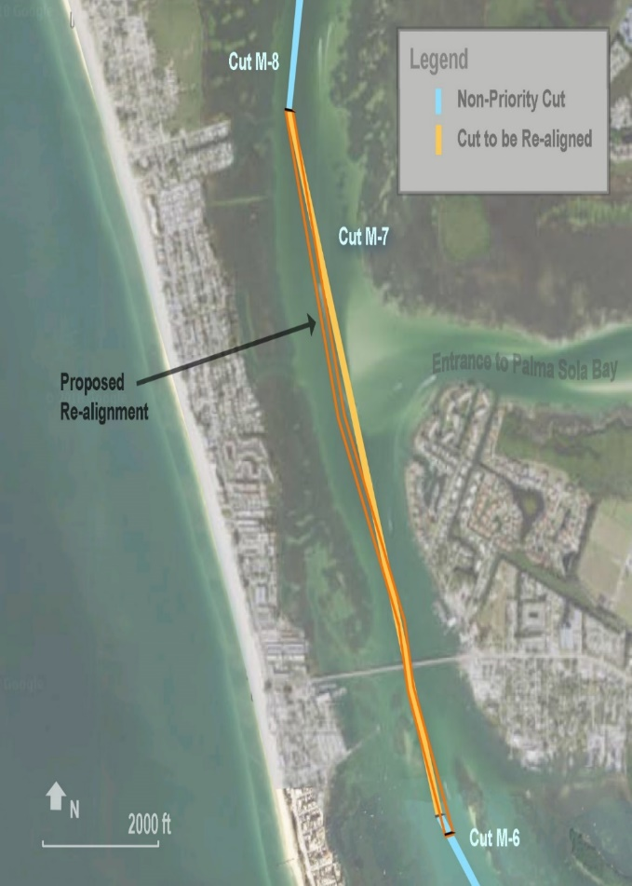
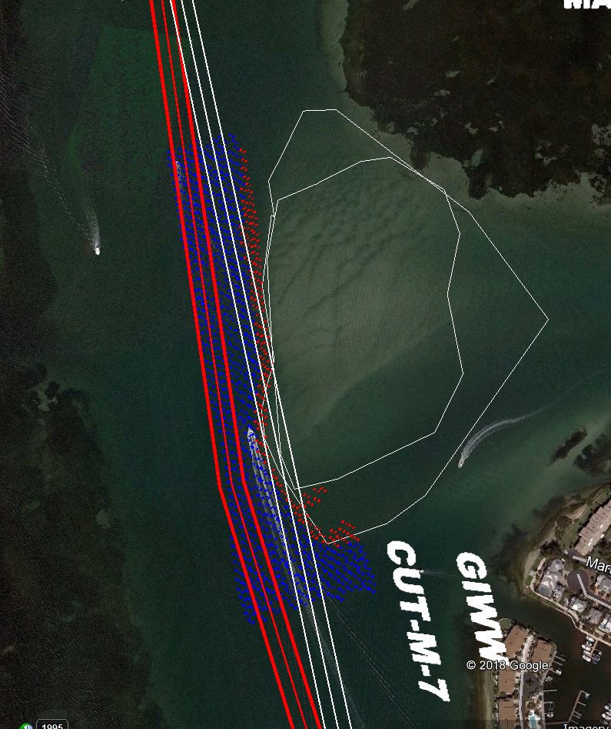
Accomplishments to date: Prioritization
BUILDING STRONG
2 GIWW Realignments : Identified shoaled areas where channel can be re-aligned rather than dredged.
Review historical shoal condition using aerials
Confirm existing deep water
Saves ~$4M in Federal O&M funding for a dredge event; more $ saved over life of the project.
Notes:
Reviewed the shoal based on 20 yrs of aerials, hasn’t changed, existing deep water to the west. Shifting channel.

Slide 15
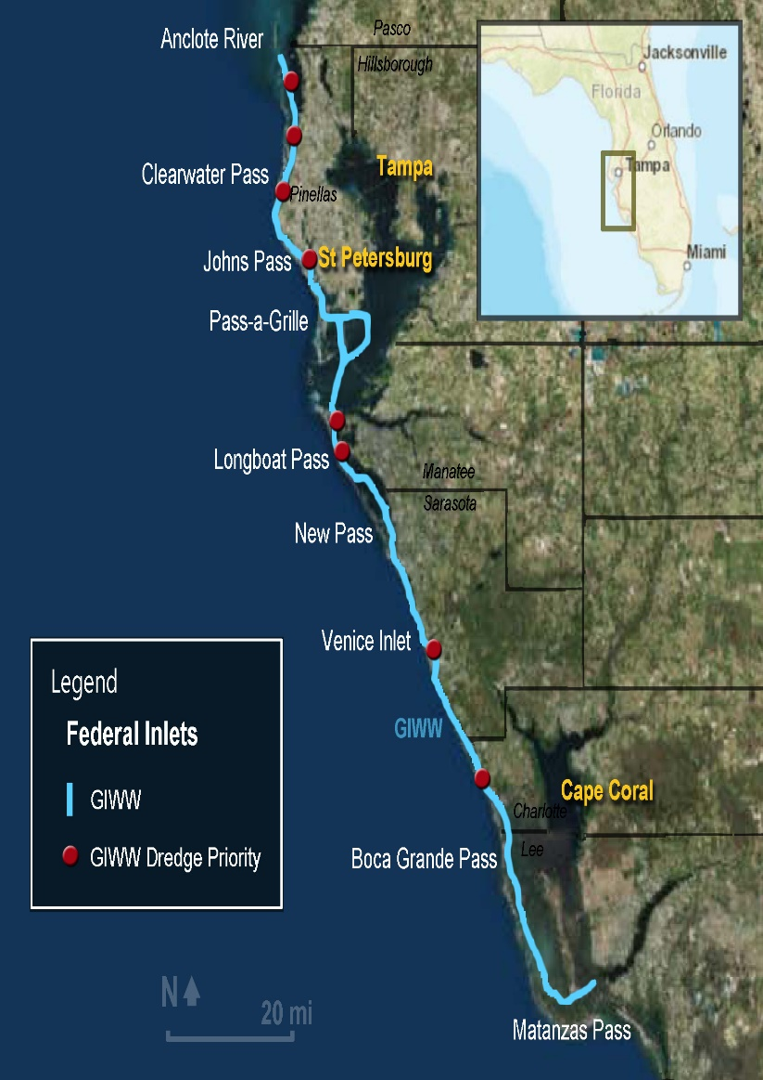
Accomplishments to date: Dredging Prioritization
BUILDING STRONG
40% down to 28% of 160 miles requiring dredging.
Separated into dredging events planned over next 15 years
Based on shoaling, high use traffic, and USCG recommendations.
Pairing future dredging with inlets and beneficial reuse opportunities.
Notes:
DMMP info?

Slide 16
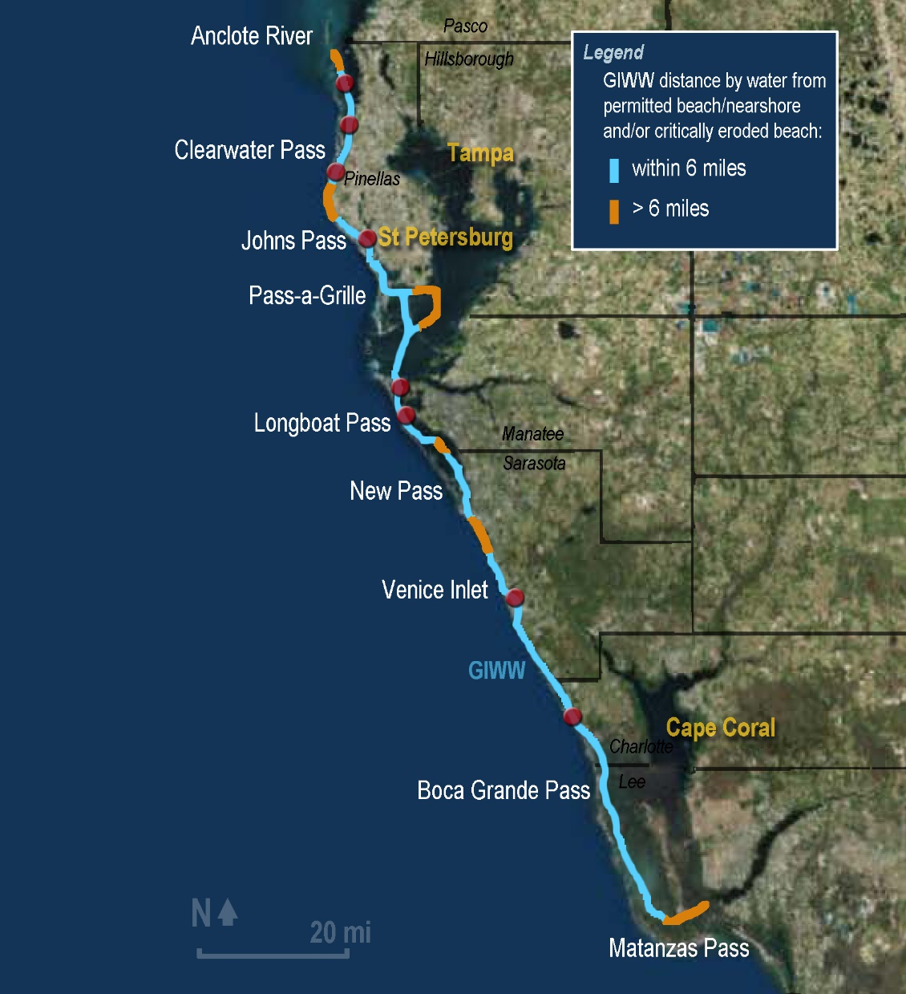
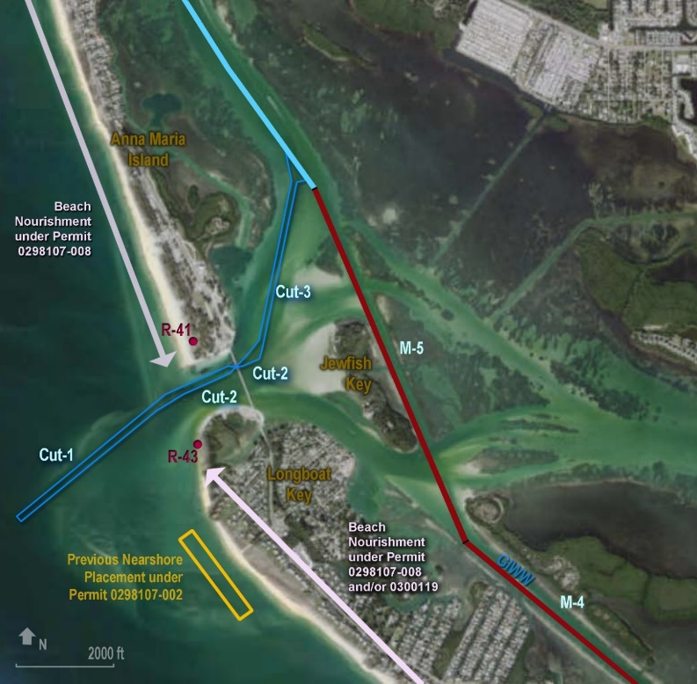
Opportunities: Proximity to potential beneficial use sites
BUILDING STRONG
Now all placement options covered under one NEPA document.
Notes:
DMMP info?

Slide 17
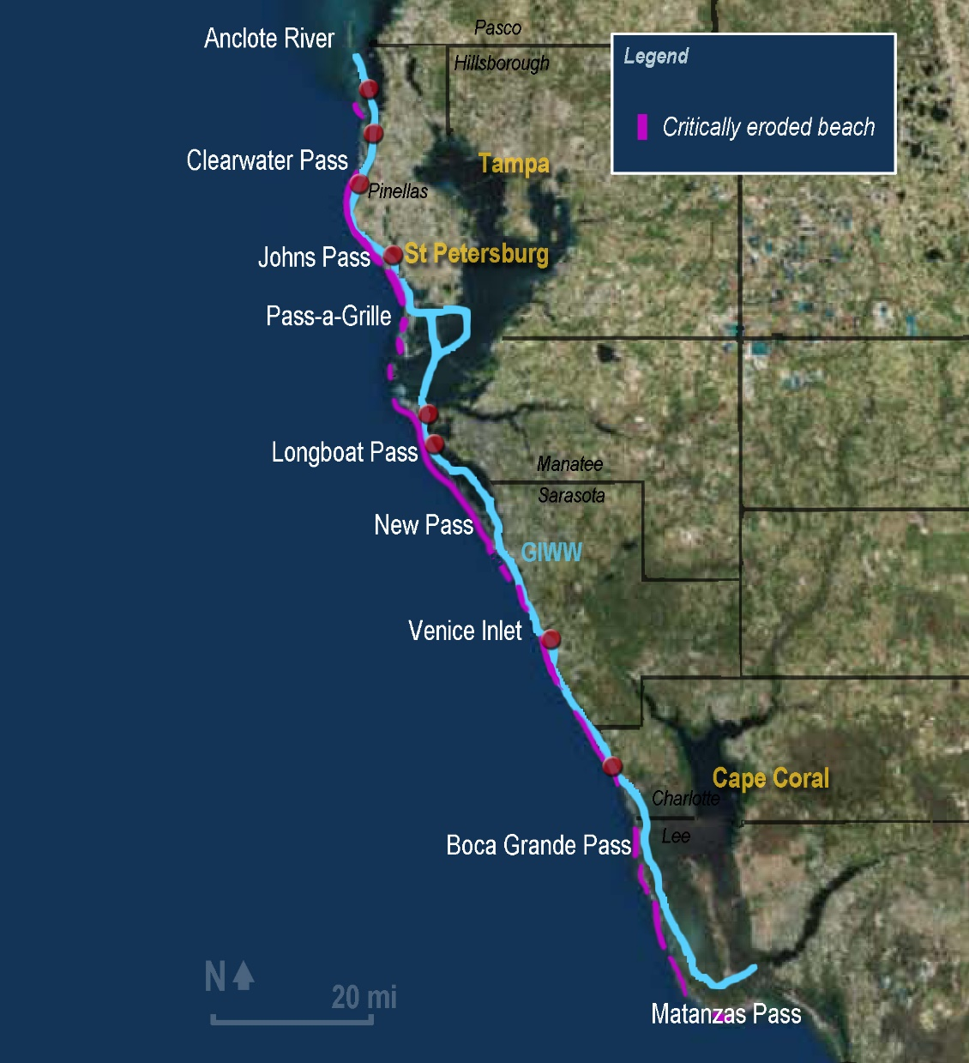
Opportunities: Proximity to potential beneficial use sites
BUILDING STRONG
Most of the beaches in the study are critically eroded.
Most of these beaches are or have been included in state DEP Joint Coastal Permits (26 in the study area).
Notes:
DMMP info?

Slide 18
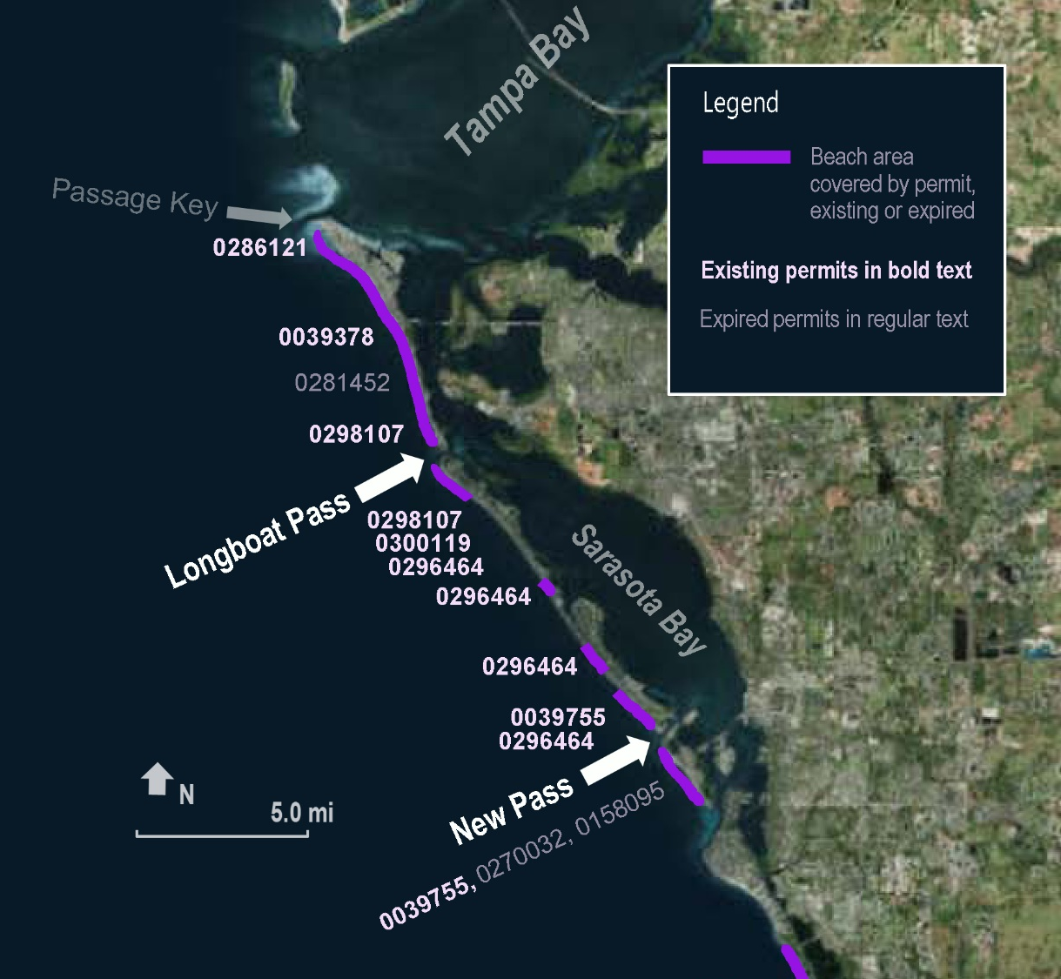
Opportunities: Increase Efficiency
BUILDING STRONG
Opportunity to regionalize permitting efforts. Expedite the process.
Looking for a broader permitting approach – for example – 6 separate JCP in effect over 17 miles.

Slide 19
Challenges: Pre-construction data needs
BUILDING STRONG
Use existing data where available and acquire new as needed:
Static
Geotech
Cultural Resources
Hardbottom
Dynamic
Bathymetry
Seagrass
Other Essential Fish Habitat
Example of existing – geotech borings at Longboat Pass

Slide 20
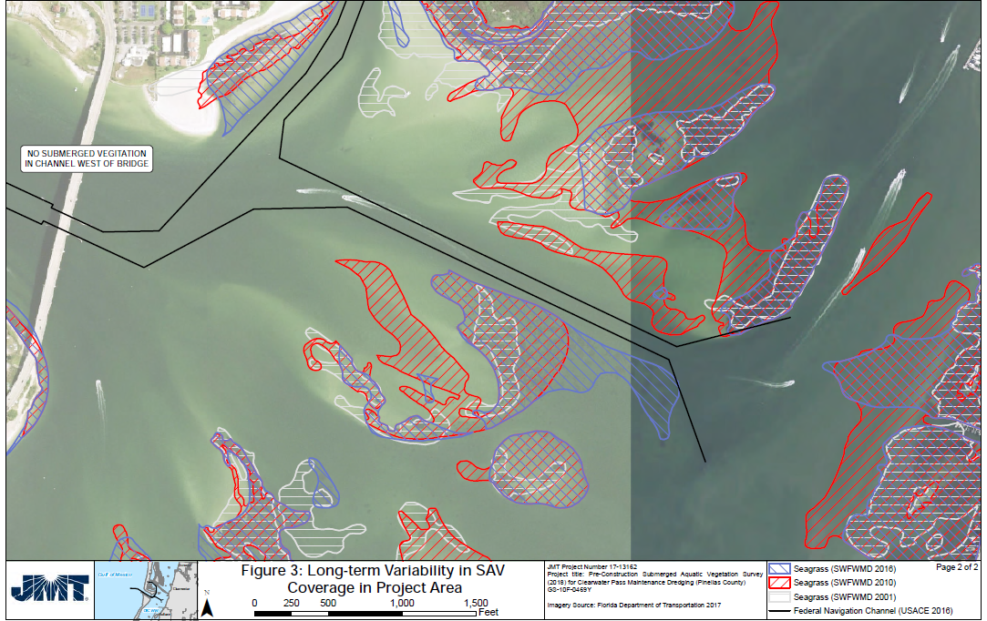
Challenges: Pre-construction data needs
BUILDING STRONG
Dynamic data like SAV exhibits changes over time; recently increased surveying requirements.
Establish data needs for pre-dredge activities vs. pre-permit activities.

Slide 21
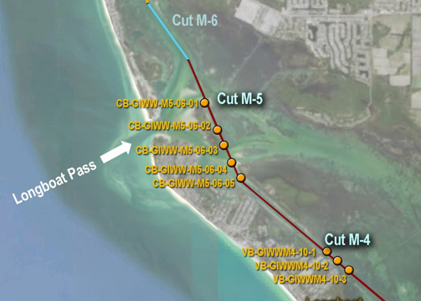
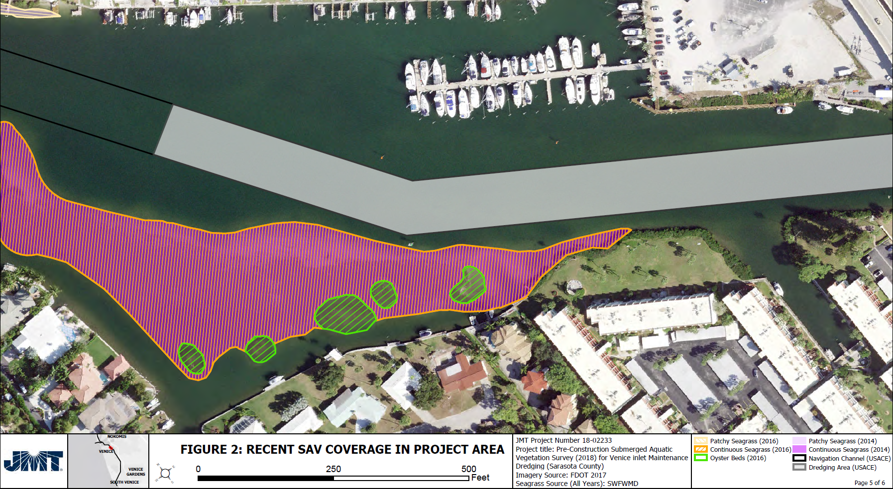
Challenges: Pre-construction data needs
BUILDING STRONG
Static: Opportunity to regionalize and create long term permits that improve management of sediment.
Dynamic: Scope out additional data needs while balancing risk/opportunity for efficiencies and mitigation.

Slide 22
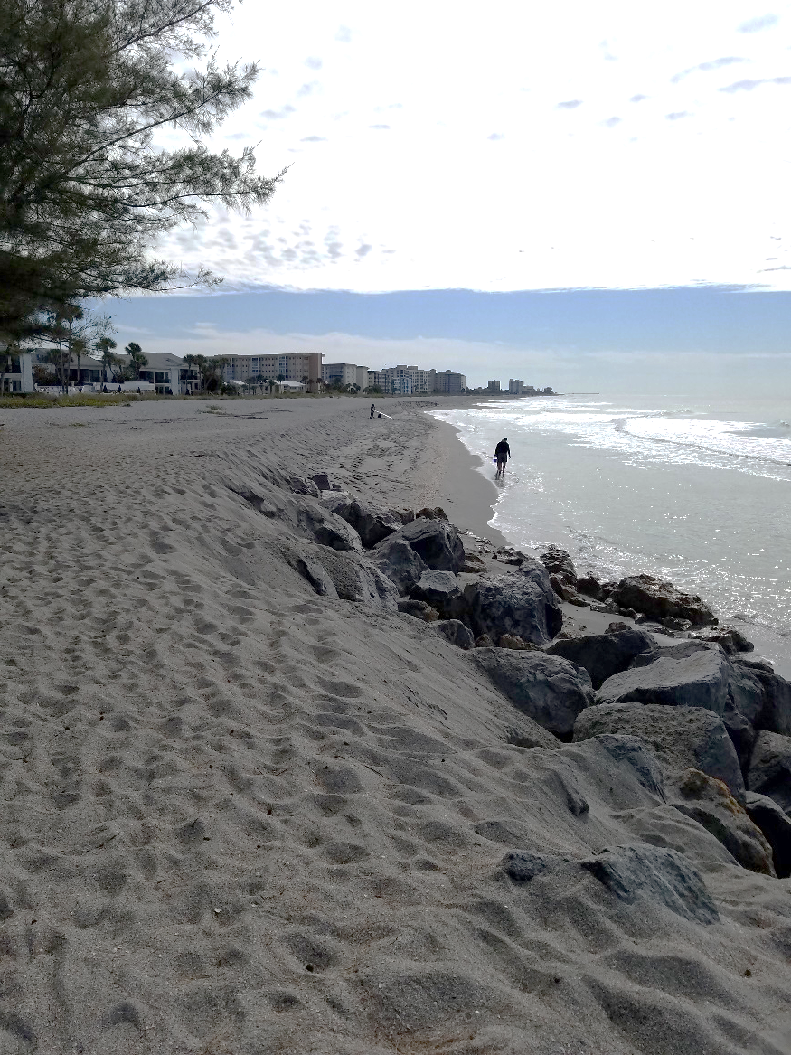
Case Study: Dredging Priority No. 1 – typical timeline
BUILDING STRONG
Venice Inlet/GIWW:
Began Plans and Specs in September 2017
Geotech acquired Feb 2018
DEP permit application submitted April 2018
Surveys complete (with seagrass to be done prior to construction) June 2018
DEP permit issued Jan 2019
Ready for construction summer 2019
Notes:
NTP items for permits. Environmental has the longest lead time.
Calculated risk associated with shoaling. P&S can be put together very quickly.

Slide 23
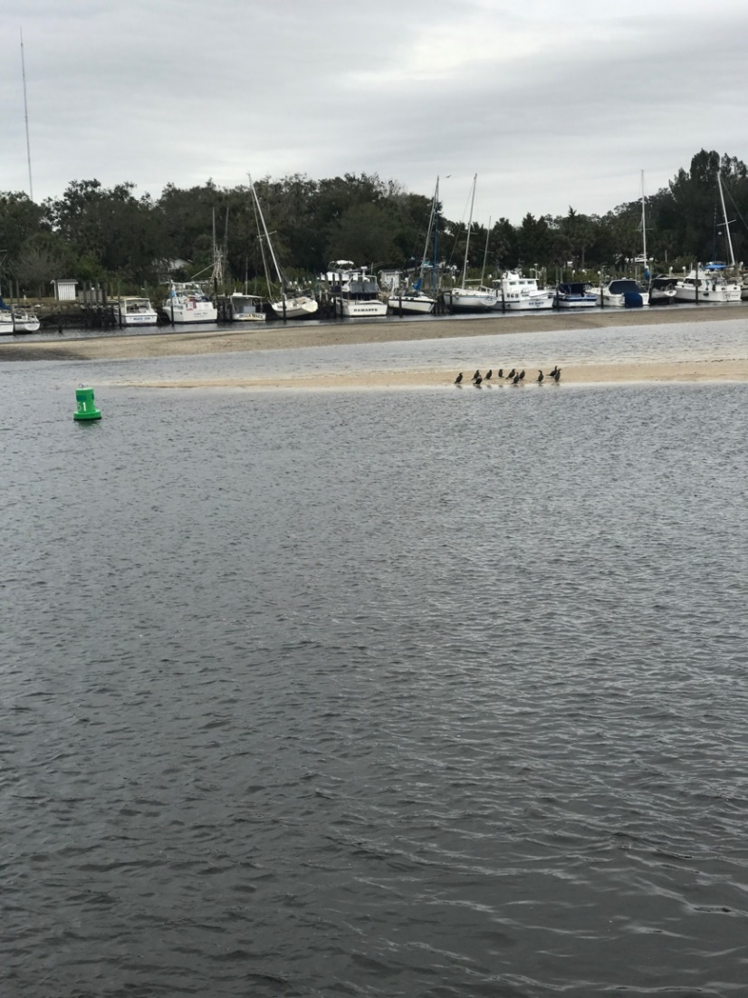
Case Study: Second-tier EA – Anclote River Channel
BUILDING STRONG
July 2018 - Class 3 Supplemental (P.L 115-123) Appropriations Notification
First site-specific EA tiered off the programmatic – efficiency realized:
Document completed in 2 months.
Public meetings done with programmatic
Notes:
Example of a low use, typically never funded Inlet all of a sudden received funding.

Slide 24
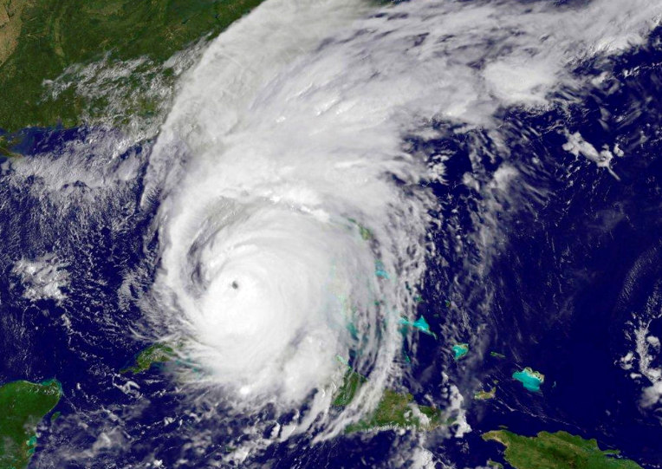
Future Opportunities Supplemental funding
BUILDING STRONG
$40M in Supplemental (P.L. 115-123) Class 3 O&M for West Coast Inlets was reallocated 7 months after appropriation.
Annual Costs to run the DROP; rolling collection of dynamic data, maintain geoportal, etc ~ $200K/yr.
Notes:
ADD BUDGET EXERCISE?

Slide 25
DROP moving forward – Save time, money, and effort
BUILDING STRONG
Complete Programmatic EFH, ESA, and SHPO consultations.
Look for new ways to apply regional sediment management techniques.
Complete Programmatic FDEP permits that allow for expedited review each event.
Establish Department of Army Regional General Permit for FL West Coast.
Notes:
ADD BUDGET EXERCISE?

